Slide 1
The Operator Pattern
Managing Stateful Services in Kubernetes
Jakob Karalus, @krallistic

Slide 2
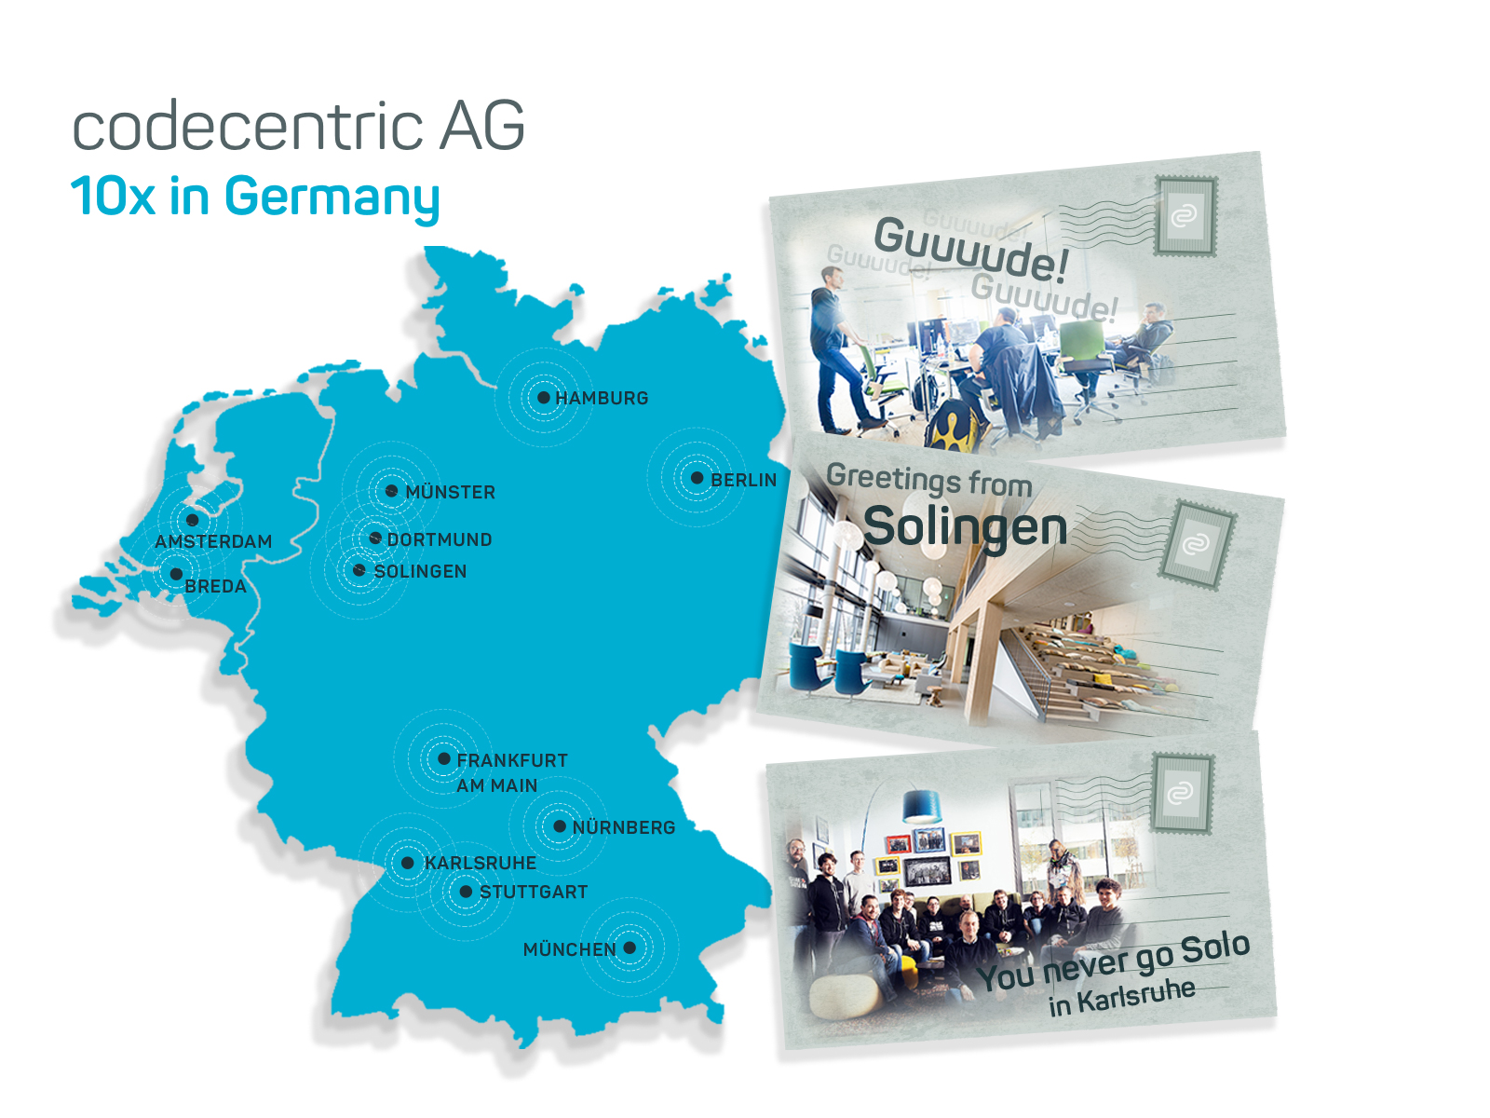

Slide 3
Normal Kubernetes Deployment
Write some Deployment, Services, Configmaps etc
Deploy them to K8s
Maybe create a Helm Chart

Slide 4
Success?!

Slide 5
But Day 2 Operations?
Backups?
Upscaling? Reshuffle Data?
Downscaling? Without Dataloss?
Healing? Restore Backups?
Configuration? Tedious Templating?

Slide 6
If only we could automate this!
In a Kubernetes native way!

Slide 7



Operators
Kubernetes
Operator
Apache Kafka

Slide 8
Operators
Human Operational Software
Custom Software
Kubernetes Native:
CustomResourceDefinition
So lets write one:

Slide 9
CustomResourceDefinition
Defines a new API
Seamless integration with existing API
Kubectl support
apiVersion: apiextensions.k8s.io/v1beta1
kind: CustomResourceDefinition
metadata:
name: crontabs.stable.example.com
spec:
group: stable.example.com
version: v1
scope: Namespaced
names:
plural: crontabs
singular: crontab
kind: CronTab
shortNames:
- ct
validation:
# openAPIV3Schema is the schema for validating custom objects.

Slide 10
CustomResourceDefinition
Actual Object in new API
No functionality.
apiVersion: "stable.example.com/v1"
kind: CronTab
metadata:
name: my-new-cron-object
spec:
cronSpec: "* * * * */5"
image: my-awesome-cron-image
replicas: 5

Slide 11
Control Loop
Observe
Operator create WATCH on CR Objects
Analyze difference Actual vs Desired State
Act on changes
Analyze
Act

Slide 12
Kafka Basics
Broker 0
Broker 1
Broker 2
Topic: “test”
Partitions: 4
Replicas: 2
Partition 0 – Replica 0
Partition 1 – Replica 0
Partition 0 – Replica 1
Partition 2 – Replica 1
Partition 3 – Replica 0
Partition 1 – Replica 1
Partition 3 – Replica 1
Partition 2 – Replica 0
Topic: “hello”
Partitions: 8
Replicas: 3

Slide 13
Create Cluster
Create Pods
Kind: KafkaCluster
Name: analytics
Replicas: 3
POST
ADD Event
Kind: ConfigMap
Name: kafka
Data: |
Kind: Statefulset
Name: analytics
Replicas: 3
Image: Kafka

Slide 14
Downsize Cluster
Delete Pod
Kind: KafkaCluster
Name: analytics
Replicas: 2
Rebalance Topic
UPDATE
Update Event
Desired:
Kind: Statefulset
Name: analytics
Replicas: 2
Image: Kafka
Current:
Kind: Statefulset
Name: analytics
Replicas: 3
Image: Kafka
Cluster Rebalanced

Slide 15
Rebalance Topics with Hot Partitions

Slide 16
Not enough?
Extra Scheduling needs? -> Scheduler Extenders (Webhooks)
More Advanced Scheduling Features -> Custom Schedulers
Complex APIs beyond CRD -> Custom API Server with API Aggregation
Control over what object can be created -> Admission Webhooks
Control how objects should be initialized? -> Initializer
Different Runtime needs? -> CRI, CNI
Special Storage -> Flex Volumes, (CSI)

Slide 17



Other Operators
Elasticsearch
Prometheus
Postgres

Slide 18

Take a step back
Are we reinventing the Wheel?
Mesos Frameworks?
Nomad Custom Scheduler?
Docker Swarm Plugins?

Slide 19
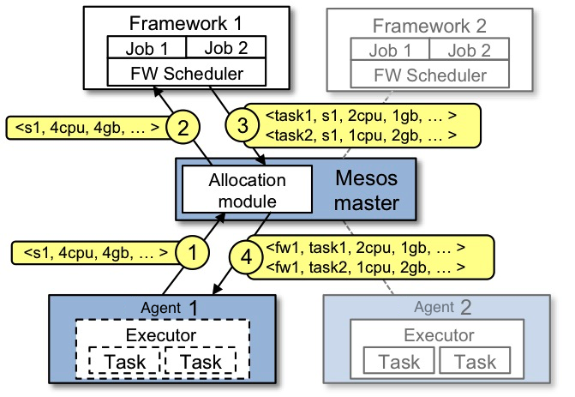
Custom Logic in Mesos

Slide 20
Comparison
Task | Mesos | Kuberentes
Custom Resource Placement | Write a framework | Write a custom scheduler
Special resource init | Write a framework | Initializer
API access | Every Framework has its own API | Unified API
Special lifecyle | Write a framework | Kubernetes Operator
Custom execution | Write a framework + executioner | CRI Interface + Scheduler

Slide 21
Questions? Discuss!

